Slide 1
Proofs: Predicate Logic
CS 236
Fall 2023

Slide 2
Overview
Topics
Proof by Resolution in Predicate Logic
Assuming you won’t have read before class this week
Due
HW 10a and 10b is due today – 10a had a typo
HW 11a and 11b is due Friday
Midterm opens Tuesday, Oct 24 through Friday Oct 27
We’ll have a review on Monday, Oct 24 Friday, Oct 20
No class on Monday, Oct 23

Slide 3
Nested quantifiers

Slide 4
Nested Quantifiers
If we have more than one variable for a predicate, then we will need multiple quantifiers
Order of the quantified variables does not matter when all the same
See Table 1, Section 1.5.3 of the book

Slide 5
Nested Quantifiers
If we have more than one variable for a predicate, then we will need multiple quantifiers
Order of the quantified variables does not matter when all the same
See Table 1, Section 1.5.3 of the book
Think of the first line as saying (p ∧ q) ∧ r = p ∧ (q ∧ r)

Slide 6
Nested Quantifiers
If we have more than one variable for a predicate, then we will need multiple quantifiers
but
Notes:
Think of the last line as generalizing the idea that (p ∧ q) ∨ r is not the same as p ∧ (q ∨ r)

Slide 7
Nested Quantifiers
If we have more than one variable for a predicate, then we will need multiple quantifiers
but
Think of the as line as saying (p ∧ q) ∨ r is not the same as p ∧ (q ∨ r)
Notes:
Think of the last line as generalizing the idea that (p ∧ q) ∨ r is not the same as p ∧ (q ∨ r)

Slide 8
Rules of Inference for Predicate Logic

Slide 9
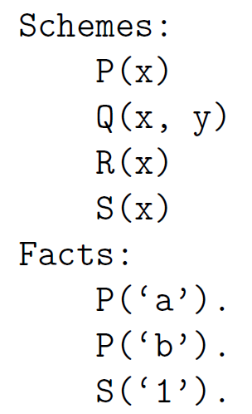
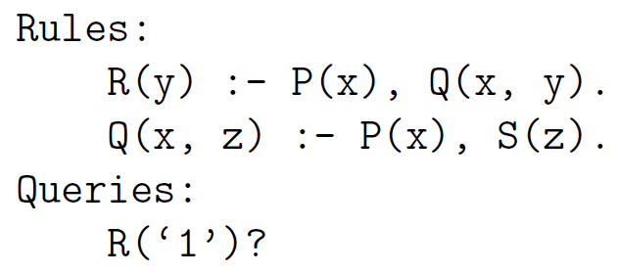
Overview
Topics
Proof by Resolution in Predicate Logic
Solve this problem

Slide 10
Overview
Topics
Proof by Resolution in Predicate Logic
Solve this problem

Slide 11
Overview
Topics
Proof by Resolution in Predicate Logic
Solve this problem
Notes:
\begin{array}{ll|l}
& \mbox{\textbf{Fact}} & \mbox{\textbf{Reason}} \\\hline
1. & P('a') & \mbox{premise} \\
2. & P('b') & \mbox{premise} \\
3. & S('1') & \mbox{premise} \\
4. & \forall x\forall y \Big[ P(x) \wedge Q(x,y) \rightarrow R(y) & \mbox{premise} \\
5. & \forall x\forall z \Big[ P(x) \wedge S(z) \rightarrow Q(x,z) & \mbox{premise}
\end{array}

Slide 12
Overview
Topics
Proof by Resolution in Predicate Logic
Prove R(‘1’)

Slide 13
Overview
Topics
Proof by Resolution in Predicate Logic
Prove R(‘1’)
We need a tool to relate quantified variables

Slide 14
Overview
Topics
Proof by Resolution in Predicate Logic
Prove R(‘1’)
We need a tool to relate quantified variables
to specific instances

Slide 15
Overview
Topics
Proof by Resolution in Predicate Logic
Prove R(‘1’)
We need a tool to relate quantified variables
to specific instances
We need a rule of inference that
always works

Slide 16
Overview
Topics
Proof by Resolution in Predicate Logic
Prove R(‘1’)
Universal instantiation
We need a tool to relate quantified variables
to specific instances
Resolution
We need a rule of inference that
always works

Slide 17
Universal Instantiation
See Table 2 in section 1.6.7
Key idea: jump back and forth between quantified variables and specific instances of them
From quantified to instance is called instantiation
From instance to quantified is called generalization

Slide 18
Universal Instantiation
HW
Photo Op
See Table 2 in section 1.6.7
Key idea: jump back and forth between quantified variables and specific instances of them
From quantified to instance is called instantiation
From instance to quantified is called generalization
Universal Instantiation
Notes:
\begin{array}{ll}
& \forall x P(x) \\\cline{2-2}
\therefore & P(c)
\end{array}

Slide 19
Universal Instantiation
HW
Photo Op
See Table 2 in section 1.6.7
Key idea: jump back and forth between quantified variables and specific instances of them
From quantified to instance is called instantiation
From instance to quantified is called generalization
Universal Instantiation
Universal quantifier
Notes:
\begin{array}{ll}
& \forall x P(x) \\\cline{2-2}
\therefore & P(c)
\end{array}

Slide 20
Universal Instantiation
HW
Photo Op
See Table 2 in section 1.6.7
Key idea: jump back and forth between quantified variables and specific instances of them
From quantified to instance is called instantiation
From instance to quantified is called generalization
Universal Instantiation
Universal quantifier
Specific instance
Notes:
\begin{array}{ll}
& \forall x P(x) \\\cline{2-2}
\therefore & P(c)
\end{array}

Slide 21
Universal Instantiation
HW
Photo Op
See Table 2 in section 1.6.7
Key idea: jump back and forth between quantified variables and specific instances of them
From quantified to instance is called instantiation
From instance to quantified is called generalization
Universal Instantiation
Universal quantifier
Specific instance
Notes:
\begin{array}{ll}
& \forall x P(x) \\\cline{2-2}
\therefore & P(c)
\end{array}

Slide 22
Using Universal Instantiation
Prove Q(‘a’,’1’)
Notes:
\begin{array}{ll|l}
& \mbox{\textbf{Fact}} & \mbox{\textbf{Reason}} \\\hline
1. & P('a') & \mbox{premise} \\
2. & P('b') & \mbox{premise} \\
3. & S('1') & \mbox{premise} \\
4. & \forall x\forall y \Big[ \neg P(x) \vee \neg Q(x,y) \vee R(y) & \mbox{premise} \\
5. & \forall x\forall z \Big[ \neg P(x) \vee \neg S(z) \vee Q(x,z) & \mbox{premise} \\
6. & \forall z \Big[ \neg P('a') \vee \neg S(z) \vee Q('a',z) \Big]& \mbox{universal instantiation on 5: $x \leftarrow 'a'$} \\
7. & \neg P('a') \vee \neg S('1') \vee Q('a','1') & \mbox{universal instantiation on 6: $z \leftarrow '1'$} \\
8. & \neg S('1') \vee Q('a','1') & \mbox{resolution on 1 and 7} \\
9. & Q('a','1') & \mbox{resolution on 3 and 8}
\end{array}

Slide 23
Using Universal Instantiation
Prove Q(‘a’,’1’)

Slide 24
Using Universal Instantiation
Prove Q(‘a’,’1’)

Slide 25
Using Universal Instantiation
Prove Q(‘a’,’1’)

Slide 26
Using Universal Instantiation
Prove Q(‘a’,’1’)

Slide 27
Using Universal Instantiation
Prove Q(‘a’,’1’)
Line 7 is just a compound proposition

Slide 28
Using Universal Instantiation
Prove Q(‘a’,’1’)
Line 7 is just a compound proposition
so we can use resolution

Slide 29
Using Universal Instantiation
Prove Q(‘a’,’1’)
Line 7 is just a compound proposition
so we can use resolution

Slide 30
Using Universal Instantiation
Prove Q(‘a’,’1’)
Line 7 is just a compound proposition
so we can use resolution

Slide 31
Predicate Logic: Proof by Resolution
Proof by Resolution in Predicate Logic:
Convert all predicates into CNF-like predicates
Convert the implications and bi-implications to disjunction
Apply conditional-disjunction equivalence
Move negations inward with De Morgan’s laws
Use Distributive laws to group disjunction
Use Universal Instantiation to create a proposition
Use Resolution to prove new premises
Repeat steps 2 and 3 until proof is finished

Slide 32
Predicate Logic: Proof by Resolution
Proof by Resolution in Predicate Logic:
Convert all predicates into CNF-like predicates
Convert the implications and bi-implications to disjunction
Apply conditional-disjunction equivalence
Move negations inward with De Morgan’s laws
Use Distributive laws to group disjunction
Use Universal Instantiation to create a proposition
Use Resolution to prove new premises
Repeat steps 2 and 3 until proof is finished
We won’t teach the whole procedure for converting any expression to CNF, just one special type of expression

Slide 33
Predicate Logic: Proof by Resolution
Proof by Resolution in Predicate Logic:
Convert all predicates into CNF-like predicates
Convert the implications and bi-implications to disjunction
Apply conditional-disjunction equivalence
Move negations inward with De Morgan’s laws
Use Distributive laws to group disjunction
Use Universal Instantiation to create a proposition
Use Resolution to prove new premises
Repeat steps 2 and 3 until proof is finished
Key differences from Propositional Logic

Slide 34
Predicate Logic: Proof by Resolution
Proof by Resolution in Predicate Logic:
Convert all predicates into CNF-like predicates
Convert the implications and bi-implications to disjunction
Apply conditional-disjunction equivalence
Move negations inward with De Morgan’s laws
Use Distributive laws to group disjunction
Use Universal Instantiation to create a proposition
Use Resolution to prove new premises
Repeat steps 2 and 3 until proof is finished

Slide 35
Predicate Logic: Proof by Resolution
Proof by Resolution in Predicate Logic:
Convert all predicates into CNF-like predicates
Convert the implications and bi-implications to disjunction
Apply conditional-disjunction equivalence
Move negations inward with De Morgan’s laws
Use Distributive laws to group disjunction
Use Universal Instantiation to create a proposition
Use Resolution to prove new premises
Repeat steps 2 and 3 until proof is finished
Conversion Steps
Use conditional disjunction equivalence
Move negation inwards via Demorgan’s laws
Use distribution to turn into disjunction

Slide 36
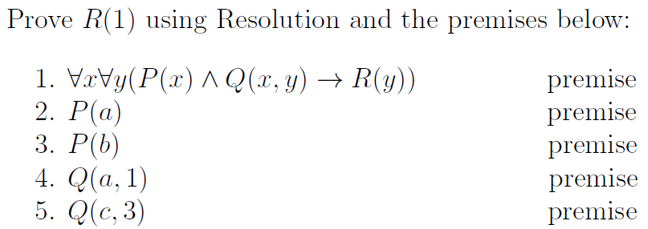
Proof Example

Slide 37
Proof Example
This is the special expression form that you’ll need to know how to convert to CNF

Slide 38
Proof Example
Conversion Steps
Use conditional disjunction equivalence
Move negation inwards via Demorgan’s laws
Use distribution to turn into disjunction
This is the special expression form that you’ll need to know how to convert to CNF

Slide 39
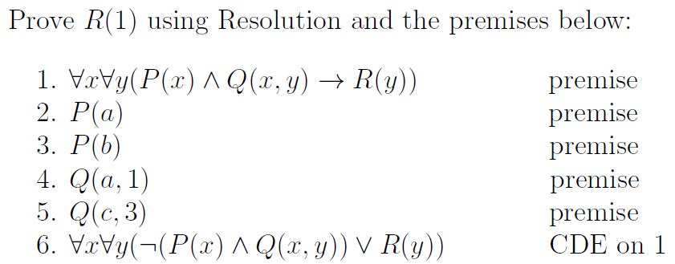
Proof Example
Conversion Steps
Use conditional disjunction equivalence
Move negation inwards via Demorgan’s laws
Use distribution to turn into disjunction
Step 1a

Slide 40
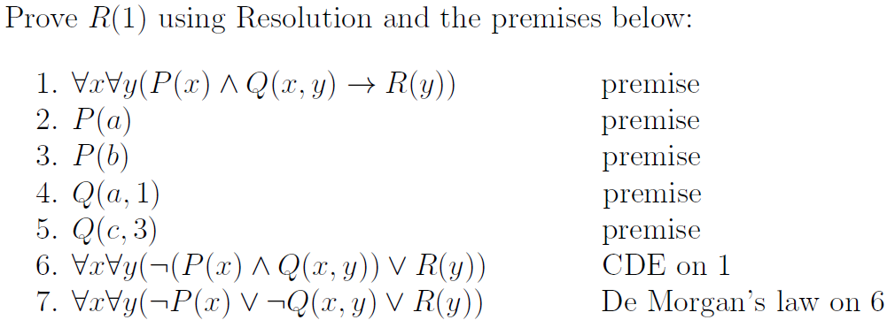
Proof Example
Conversion Steps
Use conditional disjunction equivalence
Move negation inwards via Demorgan’s laws
Use distribution to turn into disjunction
Steps 1b – 1c

Slide 41
Proof Example
Conversion Steps
Use conditional disjunction equivalence
Move negation inwards via Demorgan’s laws
Use distribution to turn into disjunction
Conjunctive Normal Form

Slide 42
Predicate Logic: Proof by Resolution
Proof by Resolution in Predicate Logic:
Convert all predicates into CNF-like predicates
Convert the implications and bi-implications to disjunction
Apply conditional-disjunction equivalence
Move negations inward with De Morgan’s laws
Use Distributive laws to group disjunction
Use Universal Instantiation to create a proposition
Use Resolution to prove new premises
Repeat steps 2 and 3 until proof is finished
Proof Steps
Convert to CNF-like
Use universal instantiation
Use resolution
Repeat

Slide 43
Proof Example
Proof Steps
Convert to CNF-like
Use universal instantiation
Use resolution
Repeat

Slide 44
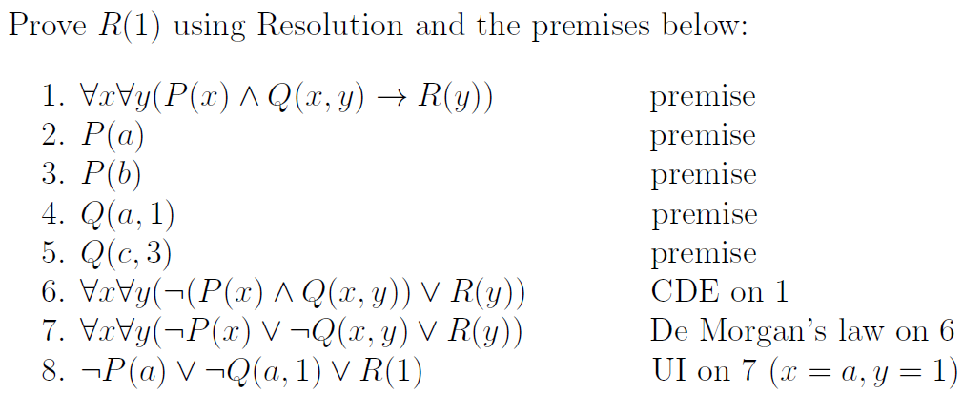
Proof Example
Proof Steps
Convert to CNF-like
Use universal instantiation
Use resolution
Repeat
Step 2

Slide 45
Proof Example
Proof Steps
Convert to CNF-like
Use universal instantiation
Use resolution
Repeat
Step 2
If it’s true for all x, it has to be true for every specific element of the domain

Slide 46
Proof Example
Proof Steps
Convert to CNF-like
Use universal instantiation
Use resolution
Repeat
Step 2
We get to choose which element
Why choose 𝑎 and 1?
𝑎 represents one specific element

Slide 47
Proof Example
Proof Steps
Convert to CNF-like
Use universal instantiation
Use resolution
Repeat
Step 2
We get to choose which element
Why choose 𝑎 and 1?
Match something we know in the KB

Slide 48
Proof Example
Proof Steps
Convert to CNF-like
Use universal instantiation
Use resolution
Repeat
Step 2
Notes:
Actually two steps x→ a and y→1

Slide 49
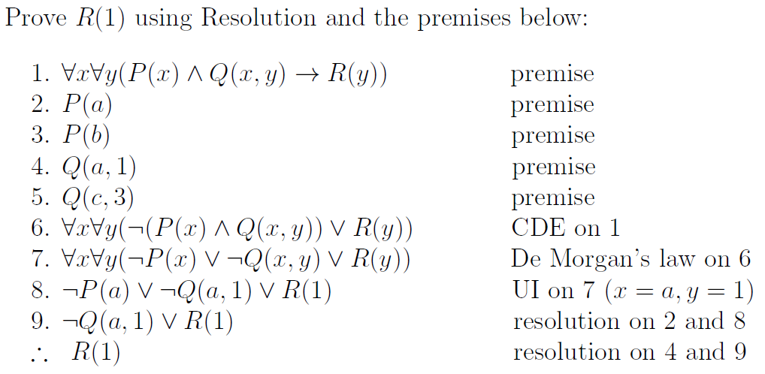
Proof Example
Proof Steps
Convert to CNF-like
Use universal instantiation
Use resolution
Repeat
Step 3

Slide 50
Proof Example
Proof Steps
Convert to CNF-like
Use universal instantiation
Use resolution
Repeat
Step 3
Once we apply UI, we can just use resolution from propositional logic

Slide 51
Proof Example
Proof Steps
Convert to CNF-like
Use universal instantiation
Use resolution
Repeat
Step 3
Now what

Slide 52
Proof Example
Proof Steps
Convert to CNF-like
Use universal instantiation
Use resolution
Repeat
Step 3

Slide 53
Proof Example
Proof Steps
Convert to CNF-like
Use universal instantiation
Use resolution
Repeat
Step 2
We get to choose which element
What if we had chosen c and 3?
𝑎 represents one specific element

Slide 54
Proof Example
Proof Steps
Convert to CNF-like
Use universal instantiation
Use resolution
Repeat (choose something else in domain)
Step 2
We get to choose which element
What if we had chosen c and 3?
𝑎 represents one specific element

Slide 55
Universal Generalization
You’ll need this on Homework 13

Slide 56
Universal Generalization

Slide 57
Universal Generalization
Specific instance
Universal quantifier

Slide 58
Universal Generalization
Specific instance
Universal quantifier

Slide 59
Universal Generalization
“the human”
Specific instance
Universal quantifier

Slide 60
Universal Generalization
Arbitrary instance
Universal quantifier

Slide 61
Universal Generalization
“a human”
Arbitrary instance
Universal quantifier

Slide 62
Universal Generalization
Arbitrary instance
Universal quantifier
c is a “place holder”
referring to an element of the domain
but not a specific element
“a human”

Slide 63
Practice

Slide 64
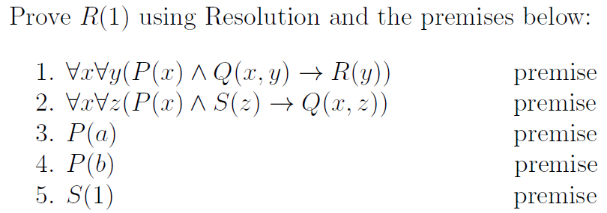
Proof Exercise

Slide 65
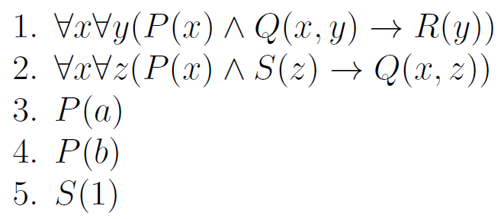

Connection to Datalog
Recall the proof premises
and the conclusion to prove
This is the corresponding Datalog program

Slide 66
Connection to Datalog
Recall the proof premises
and the conclusion to prove
This is the corresponding Datalog program
We can answer datalog queries using
proofs in predicate logic, and resolution
is the only rule of inference we need

Slide 67
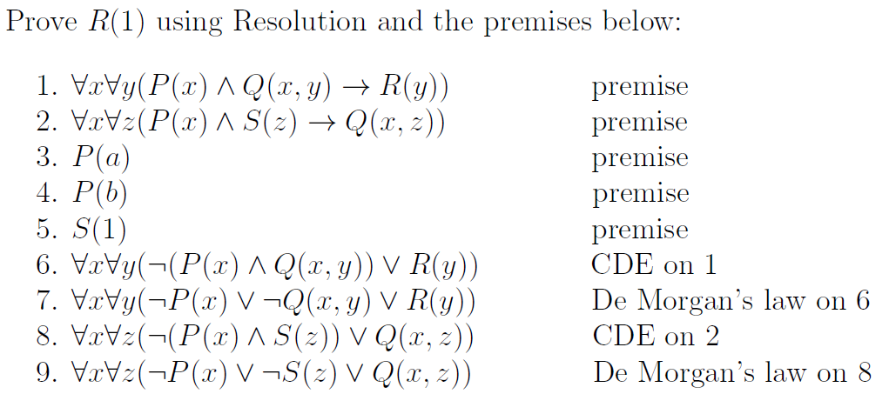
Proof Exercise
Proof Steps
Convert to CNF-like
Use universal instantiation
Use resolution
Repeat (choose something else in domain)
Step 1

Slide 68
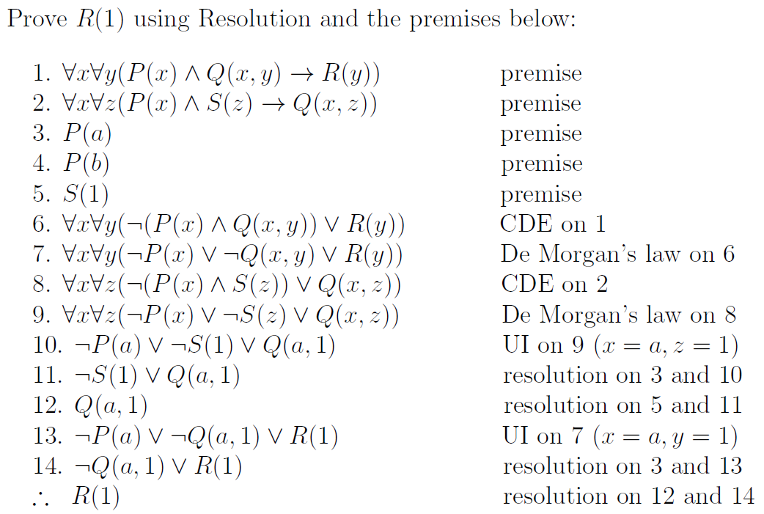
Proof Steps
Convert to CNF-like
Use universal instantiation
Use resolution
Repeat (choose something else in domain)
Step 1
Step 2
Step 3
Step 2
Step 4
Step 3

Slide 69
Proof Steps
Convert to CNF-like
Use universal instantiation
Use resolution
Repeat (choose something else in domain)
Step 2
Step 3
Step 2
Step 4
Step 3

Slide 70
Proof Steps
Convert to CNF-like
Use universal instantiation
Use resolution
Repeat (choose something else in domain)
Step 3
Step 2
Step 4
Step 3

Slide 71
Proof Steps
Convert to CNF-like
Use universal instantiation
Use resolution
Repeat (choose something else in domain)
Step 3
Step 2
Step 4
Step 3

Slide 72
Proof Steps
Convert to CNF-like
Use universal instantiation
Use resolution
Repeat (choose something else in domain)
Step 3
Step 2
Step 4
Step 3

Slide 73
Proof Steps
Convert to CNF-like
Use universal instantiation
Use resolution
Repeat (choose something else in domain)
Step 3
Step 2
Step 4
Step 3

Slide 74
Proof Steps
Convert to CNF-like
Use universal instantiation
Use resolution
Repeat (choose something else in domain)
Step 2
Step 4
Step 3

Slide 75
Proof Steps
Convert to CNF-like
Use universal instantiation
Use resolution
Repeat (choose something else in domain)
Step 2
Step 3

Slide 76
One rule to rule them all for predicate logic (plus universal instantiation)
Convert to CNF
Negate the conclusion
Use universal instantiation
Use resolution
Repeat until contradiction

